Slide 1
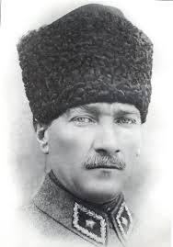
STUDENTS IN ÇANAKKALE WARS
“We buried a university in Çanakkale.”
Mustafa Kemal

Slide 2
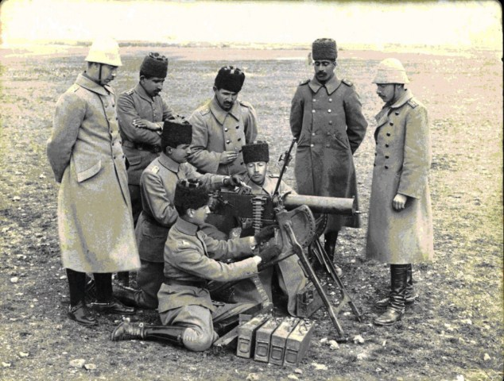
The Dardanelles campaign is the most important front line of the Great War from the perspective of Turkish history. Turks won a certain victory in Çanakkale but lost many of its educated youth there
Reserve officers during army training

Slide 3
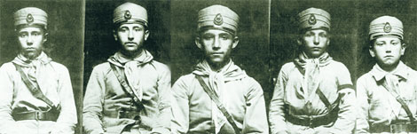
Technology and military equipment failure during the war created a disadvantageous situation for the Turkish side. Heavy casualties because of artillery shelling and bayonet charges increased the demand for fresh units and new officers.

Slide 4
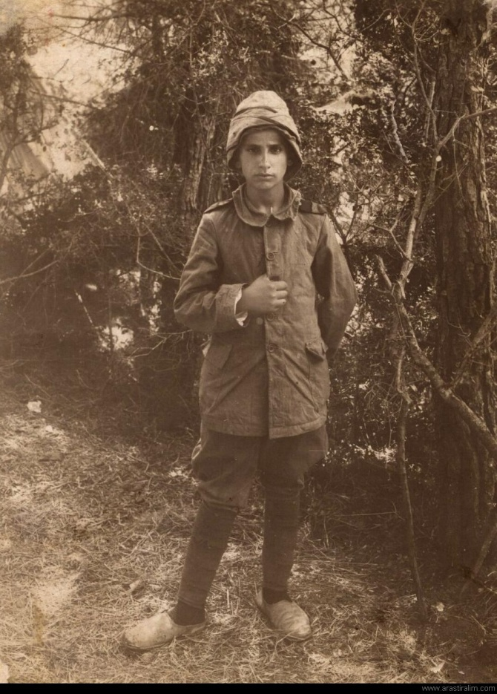
May 19, 1915 high school senior students (last grade student) across the country were recruited as sergeants. When we take the volunteer students into account, the recruitment age fell down to fifteen.
A fifteen year old volunteer water-carrier boy

Slide 5
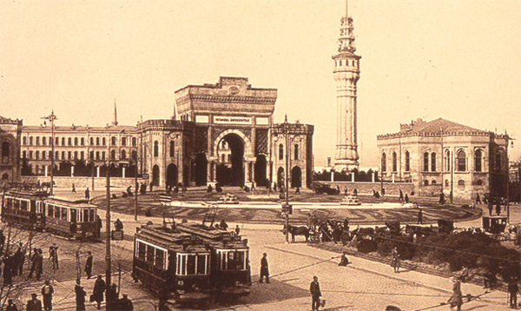
Darül Fünün (Istanbul University)were closed because almost all school students were sent to the front and the building was used as a military hospital.

Slide 6

Galatasaray Lisesi, which is the oldest school of Turkey, had 60 graduates in 1912; however, the number fell dramatically during the WWI. It had 18 graduates in 1915, 4 in 1916 and 5 in 1917.
Galatasaray High School Logo

Slide 7
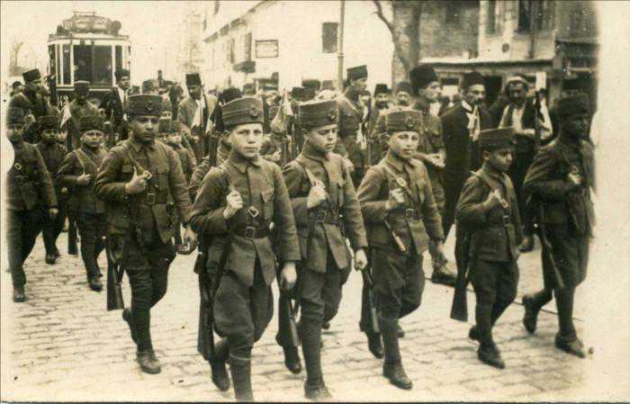
Balıkesir High School gave 98 martyrs at Dardanelles In 1917, the same school gave only two graduates. Sivas High School students who were going to the Dardanelles in 1915 wrote "Sir, we're going to the Dardanelles. Pray for us.” on the board.

Slide 8
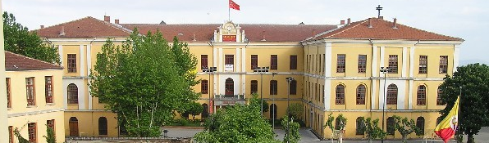
Mekteb-i Sultani changed its name as Galatasaray Lisesi after the republic era and has been the country’s opening window to the west.
Modern building of Galatasaray High School

Slide 9
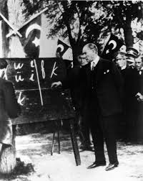
The major problem was the lack of educated people who would adopt and explain to the grassroots. To explain the benefits of a modern and secular state to the people who lived as the subjects of a Sultan for centuries was a tough job
Mustafa Kemal during alphabet revolution

Slide 10
THE END

