Slide 1
TURKISH WOMEN DURING THE ÇANAKKALE WAR
BAYRAMİÇ
SEPTEMBER 2015

Slide 2
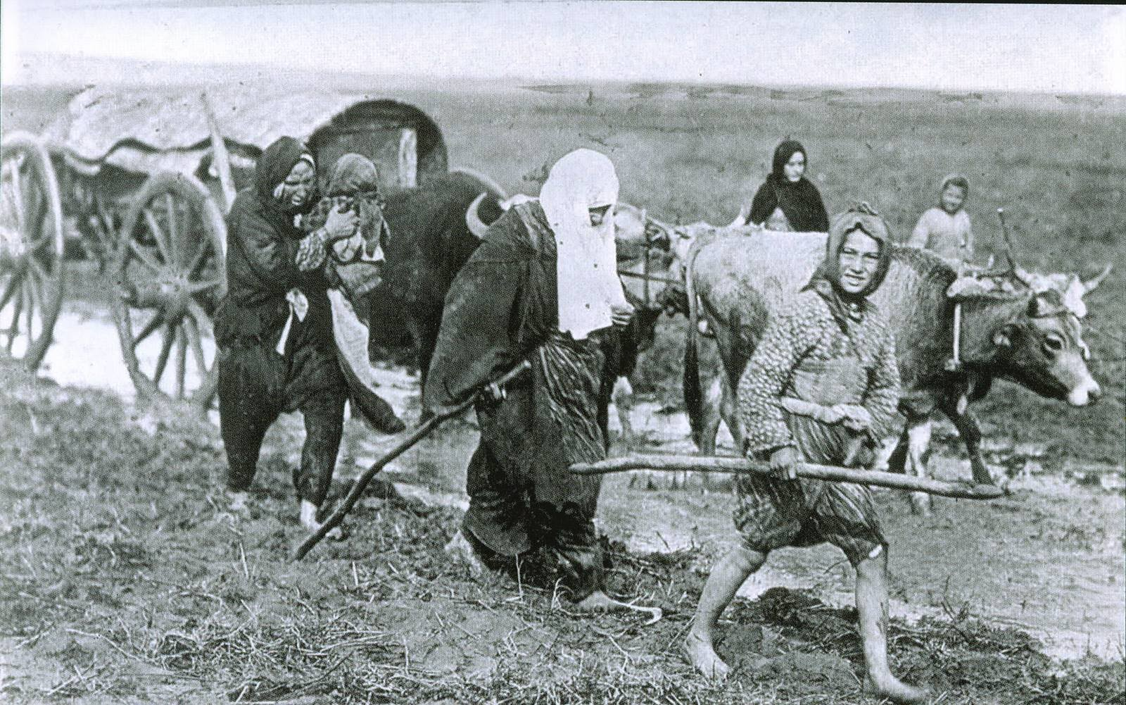
TURKISH WOMEN …
While fighting against the enemy in the frontline, supported all the efforts through numerous activities they carried out all over the country.

Slide 3
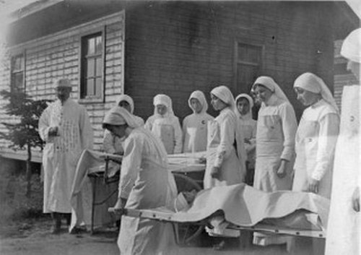
ACTIVITIES: providing health service and cloth support, collecting aid through societies and creating public opinion

Slide 4
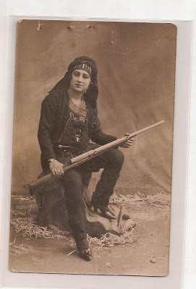
There hasn’t been a clear record on the position of the Turkish women on the front line fighting against the enemy. But on the other hand, British and the ANZAC soldiers mentioned about Turkish sniper-women in their memories.
Independence War hero Kara Fatma

Slide 5
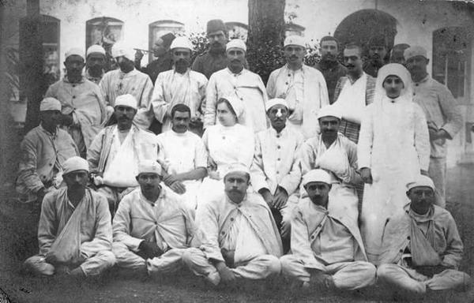
Turkish people whole-heartedly opened their homes to the wounded who couldn’t find a space in overcrowded hospitals, and organised charities and campaigns to help out the soldiers, veterans and the orphans. The real heroes of these campaigns and organisations were the Turkish women.

Slide 6
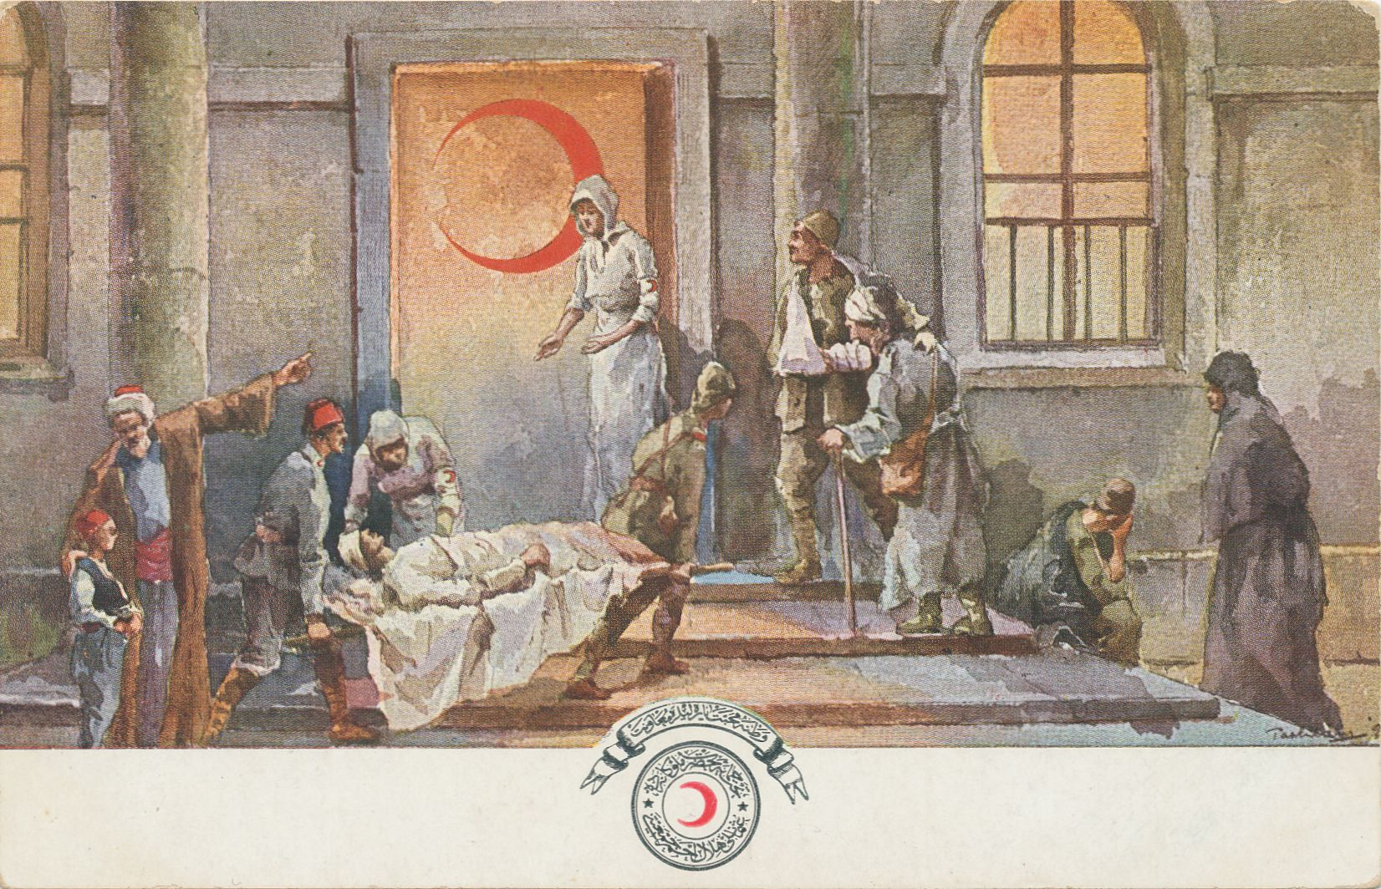
Red Crescent Ladies Association which was built 1912 during Balkan Wars was the most effective organisation, and the amounts collected there were immediately sent to the frontline or the soldiers’ families. Some of the women from this organisation worked as volunteer sisters and nurses in the field hospitals.
A postcard at those times sold for charity

Slide 7
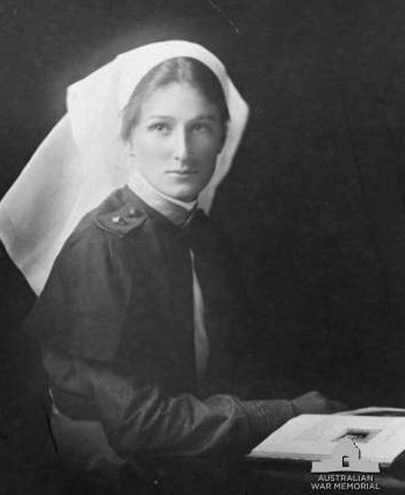
Many of our women worked as nurses and sisters at field hospitals at the line of fire. Among them, there were German, Greek and Jewish women, which is quite remarkable.
German nurse Erica died in Gallipoli due to an airstrike

Slide 8
Thank you for your patience.
THE END

